Slide 1
Data, Knowledge & Science – Thinking Outside Data
Joshua Ratha
Data Scientist, The CADS

Slide 2
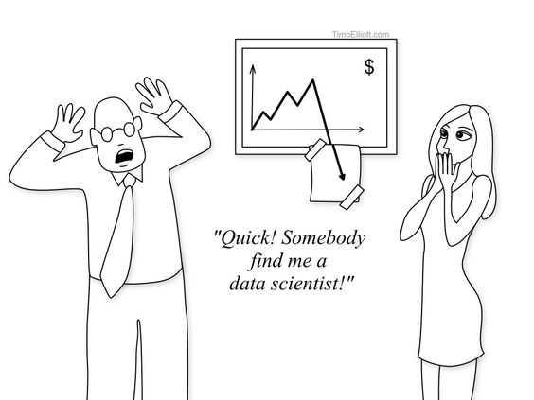
This is where you guys come in.

Slide 3
DATA
Profiling

Slide 4
The real job…
Collect data
Clean and organize data
Create model
Use more data to test and validate the model
Deployed finished model

Slide 5
Key functions
Understand the Business Problem.
Data Mining and Analysis Design.
Descriptive and Predictive Analytics.
Devising Business Strategies from Insights.

Slide 6
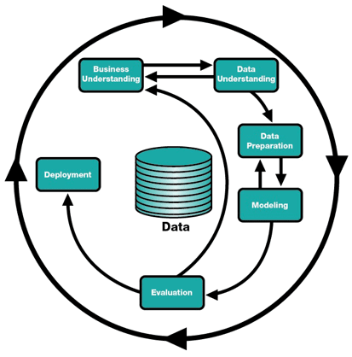
Key functions, iterative

Slide 7
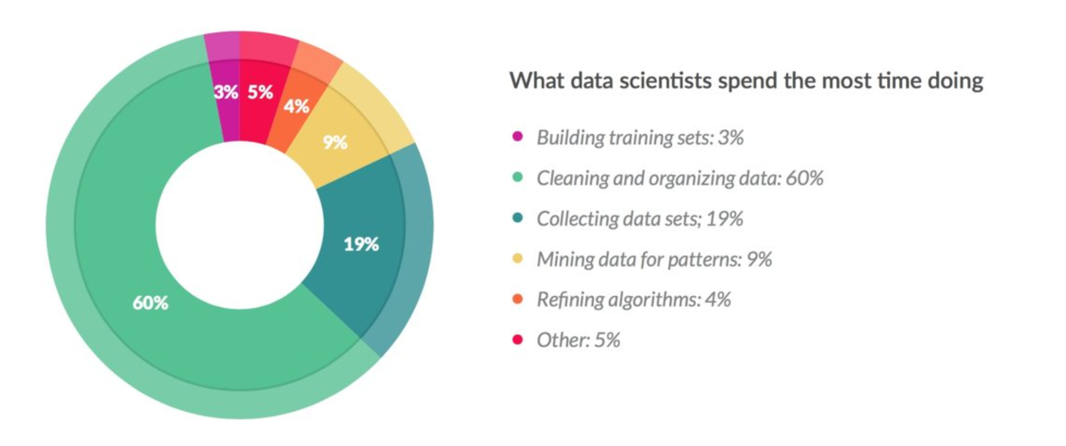
Type of Work
https://www.forbes.com/sites/gilpress/2016/03/23/data-preparation-most-time-consuming-least-enjoyable-data-science-task-survey-says/#43f15d196f63

Slide 8
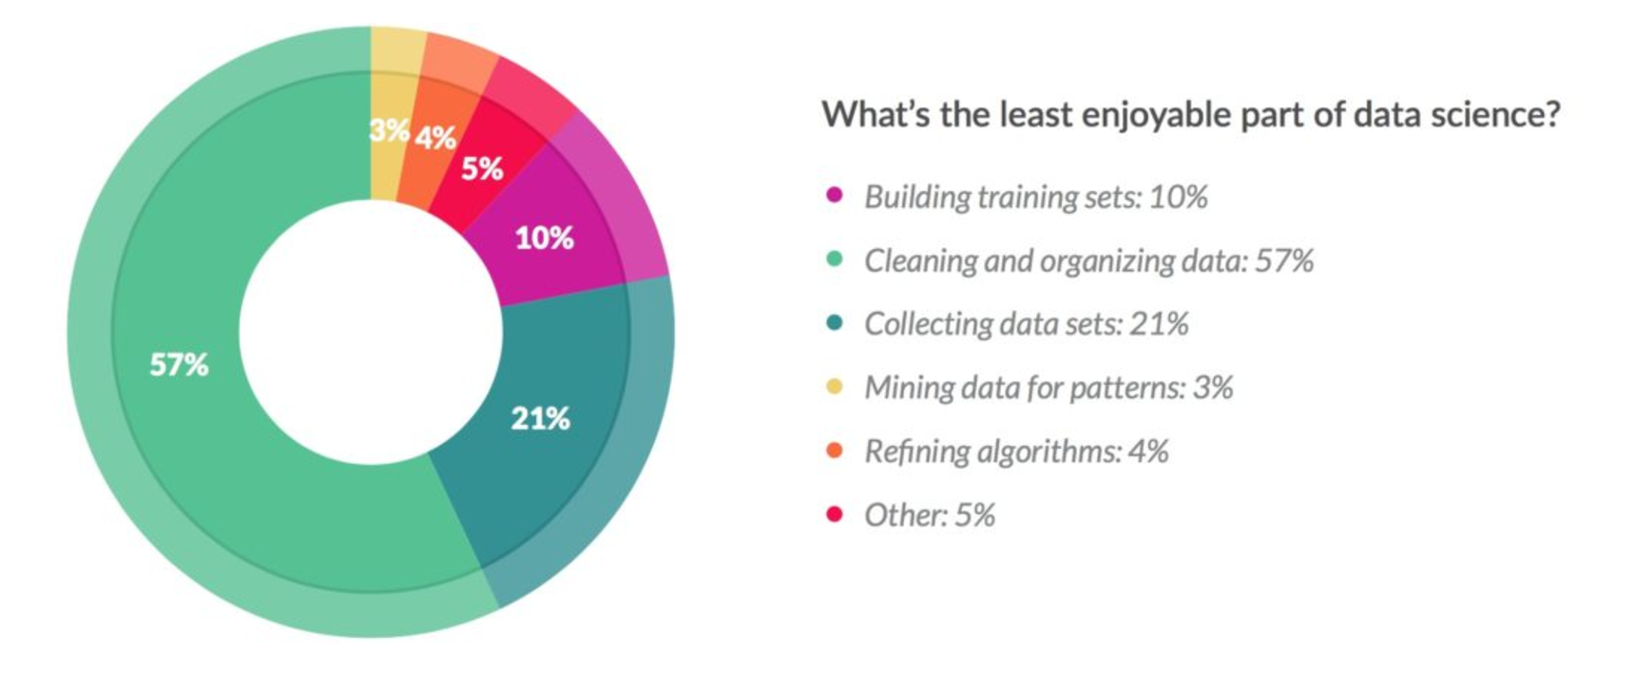
More work
https://www.forbes.com/sites/gilpress/2016/03/23/data-preparation-most-time-consuming-least-enjoyable-data-science-task-survey-says/#43f15d196f63

Slide 9
Data Governance
Data governance refers to overall management of the availability, usability, integrity and security of data.
A good governance has:
A governing body.
Defined set of procedures.
A plan of execution – in terms of creating, developing, accessing, consistency, updating, authorization, etc.
Data Governance should not be another administrative hurdle – it should be an enablement engine.
Whether or not you do Data Governance, you have Data Governance.
Notes:
has a reputation for being overly burdensome, but it all comes down to letting people know when it is their turn to make a decision.
The surrounding circles are like an orchestra with Data Governance as the conductor

Slide 10
DATA
Management

Slide 11
Data Governance
Notes:
has a reputation for being overly burdensome, but it all comes down to letting people know when it is their turn to make a decision.
The surrounding circles are like an orchestra with Data Governance as the conductor

Slide 12
Data Governance
Data governance refers to overall management of the availability, usability, integrity and security of data.
A good governance has:
A governing body.
Defined set of procedures.
A plan of execution – in terms of creating, developing, accessing, consistency, updating, authorization, etc.
Data Governance should not be another administrative hurdle – it should be an enablement engine.
Whether or not you do Data Governance, you have Data Governance.
Notes:
has a reputation for being overly burdensome, but it all comes down to letting people know when it is their turn to make a decision.
The surrounding circles are like an orchestra with Data Governance as the conductor

Slide 13
Data Architecture Management
How data is collected, stored, arranged, integrated into the work.
Simply defined as “most of what needs to be done before getting started, while and after.”
Developing an overall structure of the model.
Planning out databases and table structures.
Figuring out the key data flows.
Integrations that will need to happen between systems.
Main task:
Producing standards, structures, and frameworks to benefit mostly other technical folks.
Notes:
KEY 1: Approach data architecture like building architecture: seriously!
KEY 2: Fundamentally changing architecture during the build phase increases time, cost, and risk
KEY 3: Perfection is impossible – do not believe a data architect who insists otherwise
KEY 4: Third-normal form (3NF) has its place, but so do criminals – do not allow either to override sound logical reasoning and cost/benefit analysis
KEY 5: Buying a pre-built model may expedite parts of the process, but it is no replacement for quality data architecture talent
http://blog.westmonroepartners.com/the-5-keys-to-data-architecture-management/

Slide 14
Creating Data:
Data could take many forms:
Measurements
Numbers
Images
Aspect of data creation to be considered:
Data Management Plan.
Choosing Formats.
Intellectual Property Rights.
Data Protection and Ethics.
Any resources for study, work, research, publications, etc.

Slide 15
Data Creation
Data Management Plan.
To enable reuse of the data for future work and for any collaborative work.
Some decision to consider: software to use, how to organize, where to store data.
Legal use of data.
Back up and security.
Choosing Formats. Consider:
Textual data: XML, TXT, HTML, PDF/A (Archival PDF)
Tabular data (including spreadsheets): CSV
Databases: XML, CSV
Images: TIFF, PNG, JPEG Audio: FLAC, WAV, MP3
Intellectual Property Rights, Data Protection and Ethics.
Where can you get the data? Legal? Illegal?
Notes:
Ensures that you have adequate technological resources, data version control, IP.
Take into consideration for future projects/uses.
What would be the key factor in your final decision? Legacy issues?
(note: JPEGS are a 'lossy' format which lose information when re-saved, so only use them if you are not concerned about image quality)

Slide 16
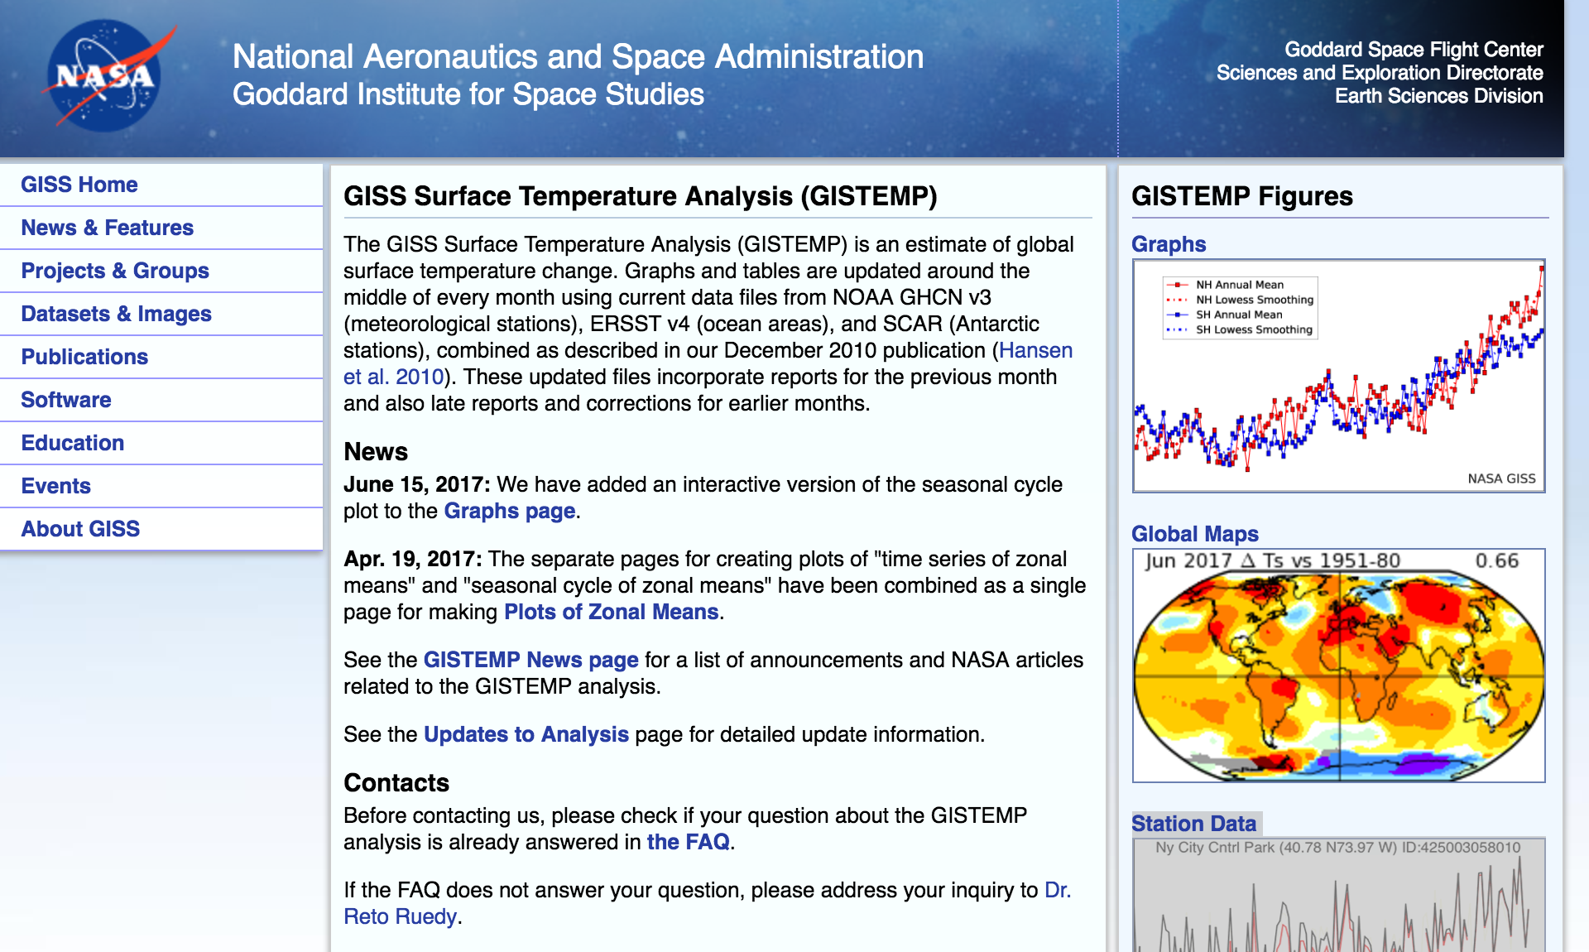
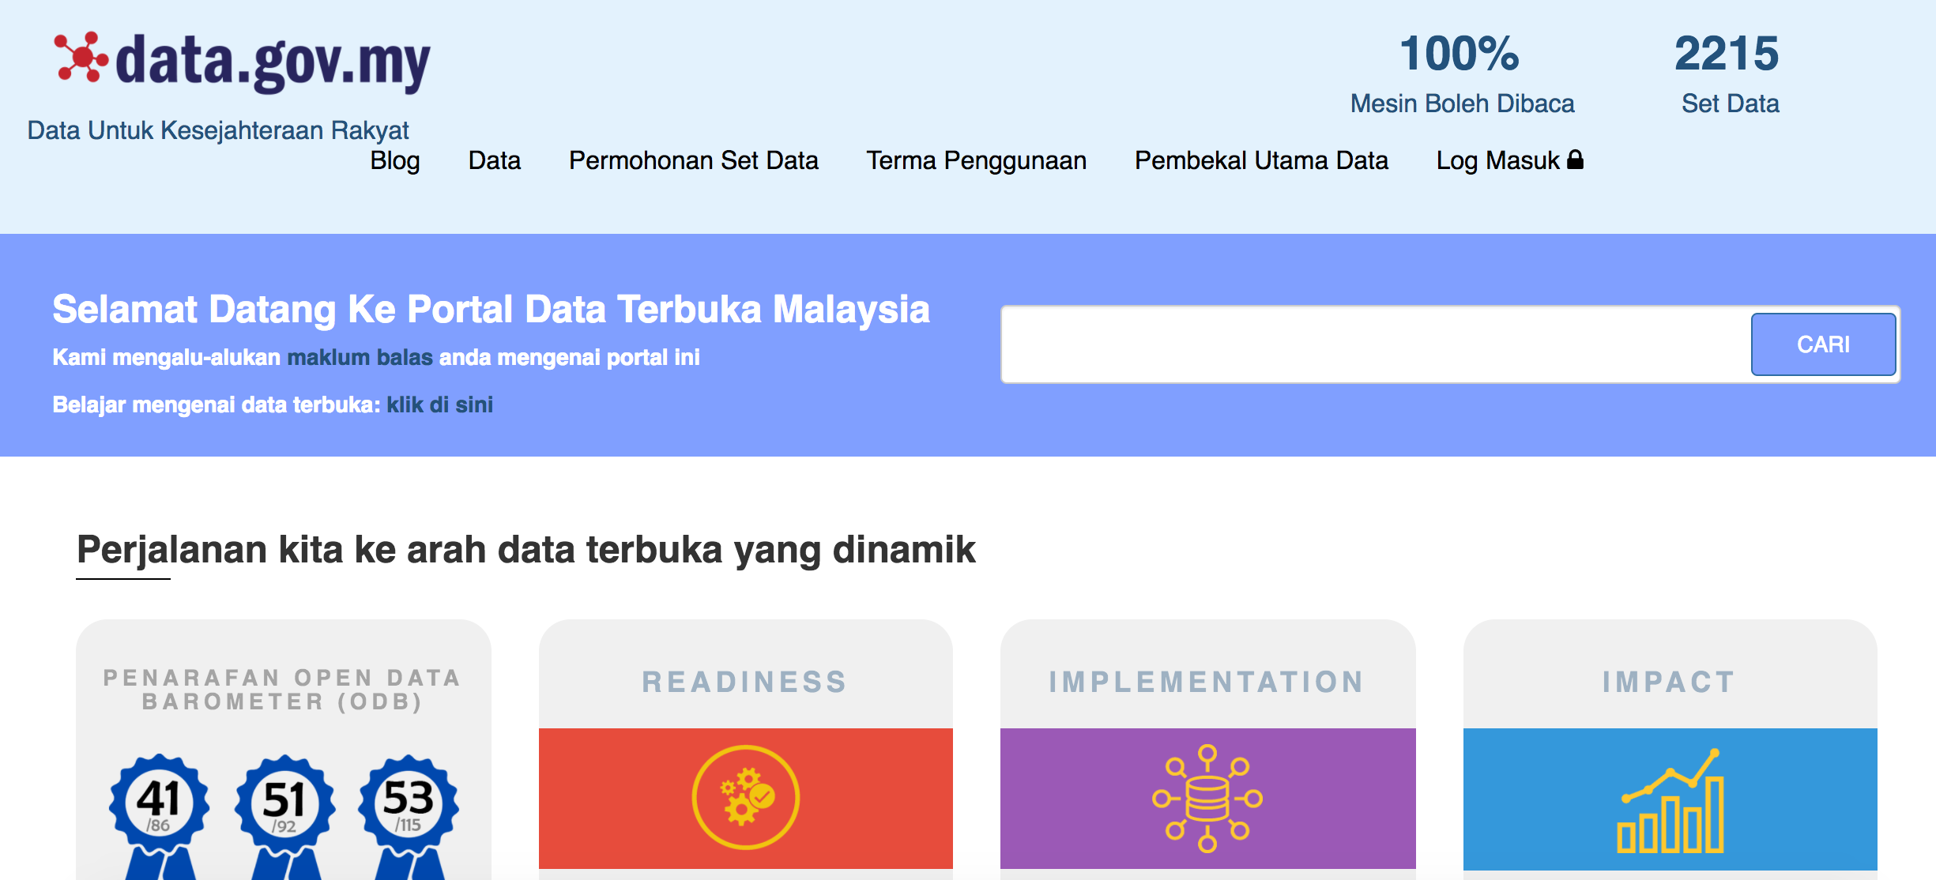
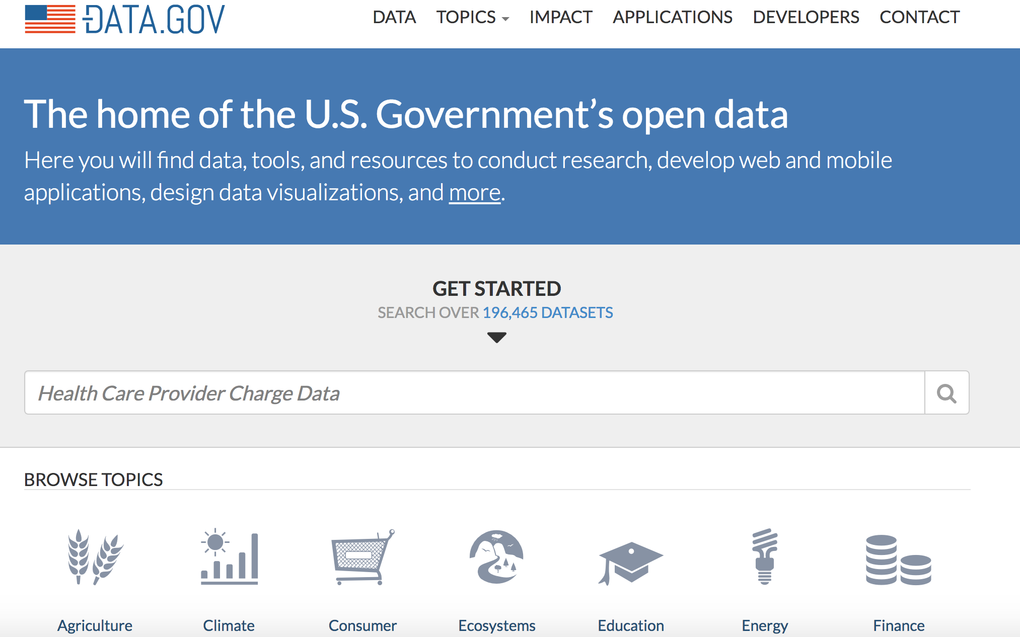
Open Data
Where else can we get the data?
Malaysia - http://www.data.gov.my/
Singapore - https://data.gov.sg/
Nasa - https://data.giss.nasa.gov/gistemp/
US - https://www.data.gov/
Notes:
Ensures that you have adequate technological resources, data version control, IP.
Take into consideration for future projects/uses.
What would be the key factor in your final decision? Legacy issues?
(note: JPEGS are a 'lossy' format which lose information when re-saved, so only use them if you are not concerned about image quality)

Slide 17
Organizing Data:
This to consider when organizing your data:
Naming and organizing files.
Documentation and metadata.
Managing references.
Version Control.
Keep a standard format for your data.
Remember: Data changes over time.
Notes:
Data governance - one person to manage the data to avoid confusion and over-riding

Slide 18
Data Development
Data development is about producing a technology-driven solution to move data from place to place.
Data development doesn’t create new data – data development is focused on the movement or changing of data
Think of your data systems as cities, and data development as the highways connecting these cities.
Move activities and change activities.
“ETL” vs. “ELT”
Notes:
KEY 1: Data development doesn’t develop data directly
KEY 2: Data development changes data very little…or entirely
KEY 3: “ETL” is usually inferior to “ELT” : Extract Load Transform, not Extract Transform Load
KEY 4: Your data developers need more understanding of the business
KEY 5: Extensibility is an Art

Slide 19
Database Operations Management
Appreciate the admin…the database administrator.
Task centers around designing and building databases.
Cloud-based databases – good or bad?
Physical hardware constraint?
DBAs must now spend more time optimizing queries for server-side computation.
Managing unstructured data.
Notes:
KEY 1: Your DBA is overworked, underappreciated, and is barely able to keep things functioning
KEY 2: There are 2 kinds of high-quality DBAs: those that do data development, and those that go DEEEEP
KEY 3: Cloud-based databases are not an excuse to ignore database operations.
KEY 4: …and neither is unstructured data
KEY 5: You shouldn’t build what you can’t support
http://blog.westmonroepartners.com/the-5-keys-to-database-operations-management/

Slide 20
Data Security Management
Data security management is not just about keeping people from accessing information they shouldn’t.
It is also about efficiently providing access to the data people need.
Identify critical or sensitive data.
If the data is not sensitive and can be accessed by anybody, then let everybody have access
If the data is sensitive, but not worth the resources to protect appropriately, then unplug it
If the data is sensitive and valuable, then find the most efficient way of protecting it, and provide the necessary resources to maintain it
Notes:
KEY 1: If your only data security goal is protecting data, just unplug it all
KEY 2: Instead of giving people access only to what they need, restrict only what must be protected
KEY 3: Complexity is the enemy
KEY 4: Don’t build what you can’t support
KEY 5: Somebody needs to hold onto the keys

Slide 21
Accessing Data:
Remote access.
Remote network connection – for cooperate.
Cloud storage.
Sharing your data.
What are the procedures available for sharing? Always check company policies.
Notes:
Remote access can be using the company network or using remote access services.
What happens once you share?
Dilution of data?

Slide 22
Looking after and Sharing Your Data:
What should you consider:
Storage – long term and preservation.
Backup - IMPORTANT.
Make a few backups.
Different locations.
Different types of storage/backup.
Digital Repositories.
Security – IMPORTANT.
Encryption - what is this? Keeping the same key?.
Masking – why mask?.
Erasure – ghost data?.
Notes:
Storage help to simplifies version control.
whether files on the network are automatically backed up, and, if so
which folders or drives on the network are backed up automatically
how frequently the backups happen, and
how long backups are stored for
Data erasure[edit]
Data erasure is a method of software-based overwriting that completely destroys all electronic data residing on a hard drive or other digital media to ensure that no sensitive data is leaked when an asset is retired or reused.
Data masking[edit]
Data masking of structured data is the process of obscuring (masking) specific data within a database table or cell to ensure that data security is maintained and sensitive information is not exposed to unauthorized personnel.
Disk encryption[edit]
Disk encryption refers to encryption technology that encrypts data on a hard disk drive.

Slide 23
KNOWLEDGE
Working the data.

Slide 24
Time to work

Slide 25
Task 1 – Data Profiling
Data profiling is an important aspect of data analytics.
It is not a “cool” work but nevertheless it is an important work that need to be done to prepare the data before analysis.
For this section, you will be using the following files (from the drive):
SC - Data Profiling.ipynb
Weather_data.csv
Follow the instructions in the .ipynb file.

Slide 26
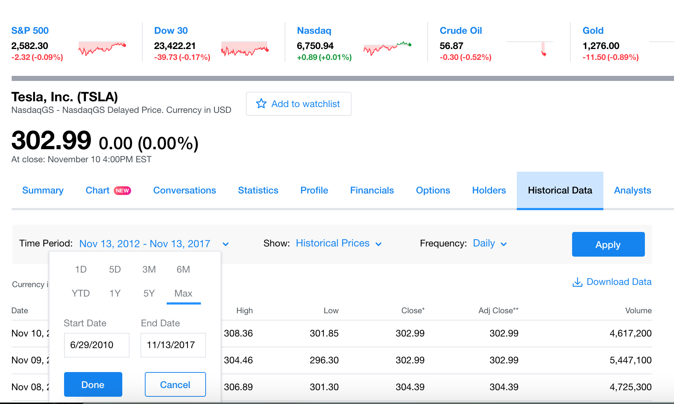
Task 2 - Do the following:
Go to:
https://finance.yahoo.com/quote/TSLA/history?p=TSLA
Search: Yahoo Finance| TSLA | Tesla Inc. | NASDAQ

Slide 27
Task 2 – Your Analytics Task
Find the following:
How many rows of data do you have?
What is the first/earliest date in the data?
What is the highest “Open” and the lowest “Open” value?
What is the highest “High” and the lowest “High” value?
What is the highest “Close” and the lowest “Close” value?
What is the average “Open”, “High” and “Close”?
What day has the highest “Open”?
What day has the highest “High”?
What day has the highest “Close”?

Slide 28
Task 3
Go to this website:
https://grouplens.org/datasets/movielens/1m/
How do we get the data?
What can we do with the data? Suggestions?
Highest rated movie of all time in the list?
What is the lowest rated movie of all time?
What is the highest rated movie every year?
What genre has the highest overall rating?
ps: use Python/R to get this information.
For answers: https://www.kaggle.com/deepmatrix/imdb-5000-movie-dataset

Slide 29
Task 3 – Things to do:
Summary for the action movie.
For every year, the most watched genre.
For each year, most watched movie genre based on gender
Most commonly used words in movie title
Most watched genre based on occupation
Most watched genre by age every year according to movie category
Based on age, most watched movies by genre
What occupation give the movie the highest rating
What date has the most users keying in the ratings

Slide 30
KNOWLEDGE
Using the Data.

Slide 31
Intuition vs. logic of humans and non-humans
Complex interplay between intuition vs. the logic of the human brain
“intuition” and brain of analytics, algorithm-based data, or artificial intelligence (AI)?
Human intuition vs brain. AI intuition?
Add to this mix the intuition behind not machines or systems that are capable of pattern-interpretation—not just pattern detection—without any risk of subconscious, human bias, and things become even more exciting.
Notes:
Point 1
It’s only natural to wonder how something that isn’t human—such as analytics or AI—can have intuitive qualities, in particular. The idea of “anthropomorphism”—where something has human characteristics—might come to mind. It really isn’t total science fiction, though.
Point 2
Think of purely subjective human intuition on one end of the spectrum, and the “brain” of purely objective data, facts, analytics, and algorithms on the other.
Mute:
A recent article — AI Intuition Beats Out Humans In Data Analysis — showcases how researchers at the Massachusetts Institute of Technology (MIT) have devised a data machine known, logically enough, as the Data Science Machine. When it comes to analyzing data and interpreting data patterns, the artificial intelligence and intuitive powers of the Data Science Machine quite simply trump those of humans.

Slide 32
PLAN WELL IN ADVANCE
Data analytics = understand and execute at an operational level.
Specifically, data science = actionable insights into the future.
Predictive analytics:
identify the exact events that cause things to change.
how this change affects other things in the short, medium, or long term.
Prescriptive analytics:
shape the outcome of future events by determining causation well in advance.
Use data science to
find actionable insights on optimal price points for products.
Accurate demand forecasting
Imagine being able to determine the demand for your products or services well in advance and not just meeting customer expectations but exceeding them. Knowing how to increase a movie’s box office revenue can prove to be a game-changer for distributors and the movie industry is getting increasingly better at it now thanks to data science.
Notes:
Prescriptive: which is the closest thing to a modern day Nostradamus that one can hope to find.
Examples:
mysmartprice.com, leading price comparison brand in India, able to recommend these optimal price points to online vendors in real time which will help increase demand for products.
Organizations that adapt to changing market dynamics tend to survive longer and the only way to avoid becoming a Kodak moment (pun intended) is to constantly try and seek what the future may hold. Not only can data science methodologies help you see the future but when done right they help you decide what to do with your future when it finally arrives.
By using data science to plan well in advance you give your sales team the opportunity to not just survive but thrive. When armed with critical information such as which leads have a high likelihood of closing, sales teams can determine which leads to prioritize. Being able to do that has a huge impact on revenue as time wasted on leads that may never convert is minimized and time spent on leads that do convert is maximized.

Slide 33
REV UP SALES
Data analytics is the modern day equivalent of cold-calling.
The difference is that data analytics is far more insightful and has a far greater success rate.
Many businesses use data analytics tools to strategize their future course of action.
Identifying the right channels using data analytics is a far more important process than it gets credit for.
According to a study by The Economist Intelligence Unit (EUI) and marketing firm ZS, a very small percentage of companies that consider data analytics an integral part of their sales and marketing efforts actually ‘get it right’.
Merely incorporating data analytics into your business because everyone else is doing it doesn’t help.
Notes:
Cold-calling = calling your potential customers to get insights into their likes, dislikes, and buying behavior before finally making your sales pitch
An example: For example, businesses want to bring as much traffic to their websites as possible and to do that they use a combination of strategies such as email marketing, social media, tools like Google AdWords et cetera. But not all of these strategies are equally relevant or successful for all kinds of businesses.
While a concerted effort in strategizing is welcome, it is far more beneficial to identify which channel is bringing the most amount of traffic to the website. If you can identify this then you can strategize accordingly and maybe decide to put more time and effort on channels that are yielding better results. This is where data analytics comes in. You may continue to use AdWords but if you had evidence that social media is fetching you far more traffic and in turn helping you sell more then there is no reason why you wouldn’t want to amp up your social media strategy.
Using data analytics to identify the right channels for lead generation, customer acquisition, and customer retention is what helps the bottom line

Slide 34
THE END
THANK YOU

